Slide 1


The impacts of Climate on Parish Councils
Approach and Outcomes

Slide 2

Context
At Feb Albury PC, we recognized the need to take further action
And agreed that with Surrey CC/ZCG and T.earth that we would lay out an approach
We agreed that the same need exists across other Parish Councils
Approach includes building an approach that can be re-used across the Tillingbourne and much more broadly
Proposed Outcomes
A playbook that any PC can use to address climate and sustainability and net zero considerations
The development of a specific PC climate impact assessment for Albury as an example output (that can help explain the approach to others)
A outline plan of actions (projects) for the PC to take forward incl potential funding sources

Slide 3
Approach
Much material already exists – we should leverage what exists…making it easier for PC to engage the material and take action
Use as foundation materials
  NALC
  Friends of the Earth
20 actions parish and town councils can take on the climate and nature emergency | Policy and insight policy.friendsoftheearth.uk
  Any other PC materials across the UK that we uncover that may be valuable
In parallel we will discuss approach and outcomes with other Tillingbourne PCs – Shere, St.Marth’s and Shalford
Timeline and Resources
Albury PC representatives
Tillingbourne.earth representatives
Surrey CC and Zero Carbon Guildford
Other Tillingbourne PC and community groups who prove interested
With Feb APC approval…interim update 6th Mar, full deliverable output for discussion 4th Apr

Slide 4
Breadth of Considerations
Potential high level impacts areas:
  Policy … we could build climate considerations into our policies
  Planning … recognise the criticality in our approach to planning and ensure our regular planning responses pick up climate issues systematically
  Community … support and encourage local action
  Other assets which a PC may be responsible for or involved in – e.g. allotments, burial grounds, verges, village greens
  Suppliers … encourage suppliers who recognise the importance of climate and sustainability and take action to address their impacts
  Transport … consider the impact on transport related matters
  Governance … the ongoing activities of PC activity
  Projects and Roadmap … an outline of potential activities and an outliner roadmap
  Funding … potential impacts over 5year horizon which PC will need to be aware of and potential sources of funding to support activity
  What should we measure and how should we measure and evidence

Slide 5
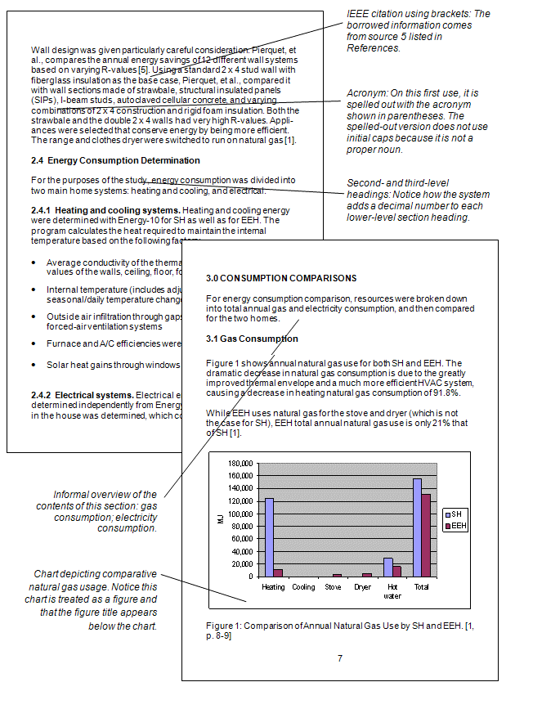
Outline deliverables
Much material already exists – we should harness what exists…making it easier for PC to engage the material and take action
Parish Council playbook
A set of steps which could be taken
And a set of supporting materials
Project template to enable funding grant requests
A set of funding sources and how to access
A set of possible grant sources
Albury projects
This Photo by Unknown Author is licensed under CC BY-SA-NC
This Photo by Unknown Author is licensed under CC BY-SA-NC
This Photo by Unknown Author is licensed under CC BY-SA-NC

Slide 6
Immediate Activity
Immediate activity and progress:
  Joint effort with Surrey CC and ZCG to build out an approach and materials to support activity
  Policy … aligning work with Neighbourhood Plan and Design Statement
  Planning … building into Neighbourhood plan
  Community … connecting with other Parish Councils – Shalford, Shere, St.Marthas
  Suppliers … single supplier list attached…to consider
  Transport … with broader x-Parish Council group

