Slide 1

Surrey County Council
Member Development Session
Community Engagement Model: Neighbourhood Area Committees
7 July 2025

Slide 2

What we will cover today…
Where we are in the timeline
Progress on new community engagement model
Next steps
Included as pre-reading but not presented on the day:
Annex: Case studies of best practice
Surrey County Council

Slide 3

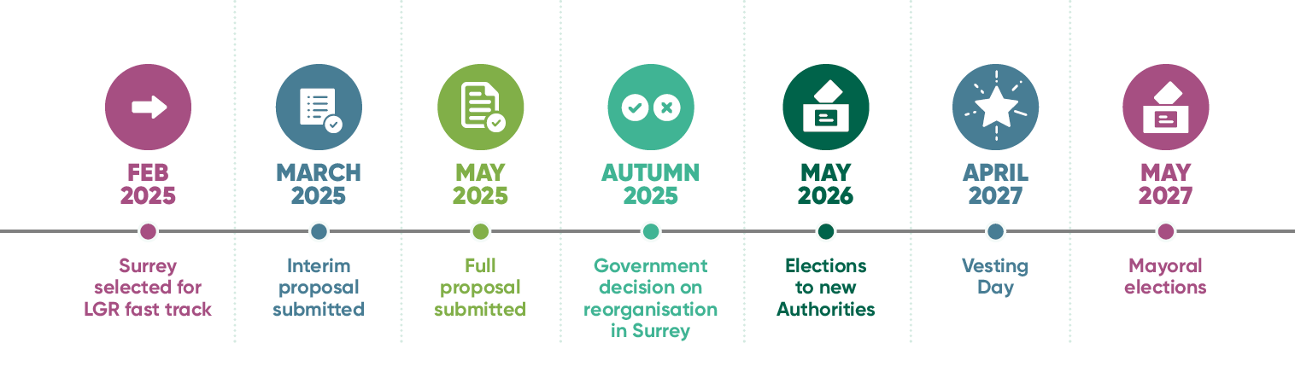
Where we are in the timeline
Surrey County Council

Slide 4
Overview
Following direction from government to hardwire local community engagement into local authority structures, the council is progressing work on a strengthened community engagement model with the development of Neighbourhood Area Committees (NACs)
We are piloting three NACs across the county in preparation for the creation of new unitary councils. These pilots will operate in rural and urban, parished and unparished areas, and we will test the name with stakeholders and communities
Our model builds upon work we’ve already done to support community participation and engagement in towns and villages
Multi-agency working will be embedded from the start, with a wide range of partners involved
NACs will drive collaborative action that promotes preventative activity and supports thriving communities
Our pilots will take a ‘test, learn and grow’ approach to exploring what works in localities with partners, supporting the development of a blueprint for the new unitary councils

Slide 5
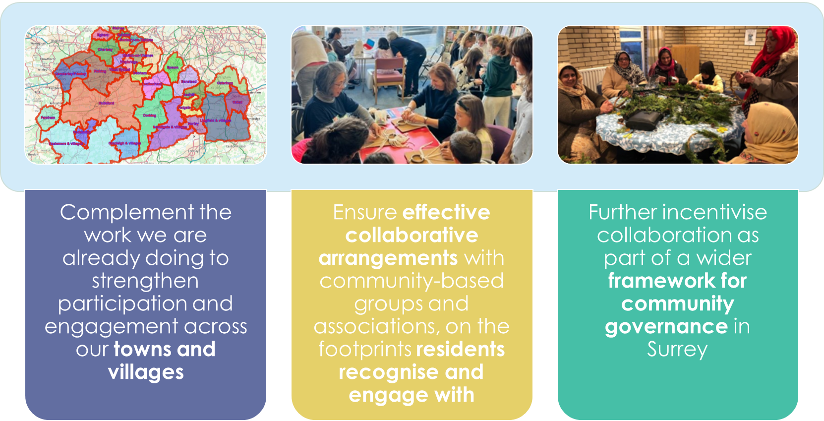
Our model for community engagement
Surrey County Council

Slide 6
Neighbourhood Area Committees: Vision
Bring together local partners to understand the key issues, agree priorities and drive collaborative action that promotes preventative activity and supports thriving communities; where everyone can access effective early support, fulfil their potential, and no one is left behind.
Core principles for Neighbourhood Area Committees
Community focused
Councillor-led as part of a strong model of democratic local community leadership
Electoral Divisions as the building blocks for logical geographies of collaboration*
Fully inclusive of all partners
Enable direct representation from residents
Data and evidence informed
Draw on insights from a range of creative and inclusive local engagement methods, in person and digital
Agree areas of local priority focus within the wider strategic frameworks set by the Unitary Councils
Drive action and improvement
Connected to local service delivery teams; but not an additional management layer
Ensure productive collaboration with Town and Parish Councils and Residents Associations where they operate
Operate within a framework of defined parameters for the appropriate range of responsibilities and delegated budgets, to enable the arrangements to have real impact
*unless there is strong consensus for deviation from this

Slide 7
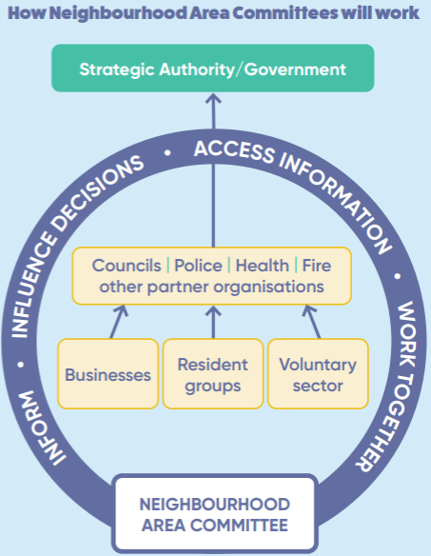
Purpose and Focus
  Understand key local issues
  Agree priorities and champion collaborative action
  Promote preventative activity
  Support thriving communities
  Act as advisory bodies (not constituted)
  Supported by a range of engagement tools
Pilots will inform the design of future engagement structures under the proposed unitary authority model using a structured ‘test, learn and grow’ process

Slide 8
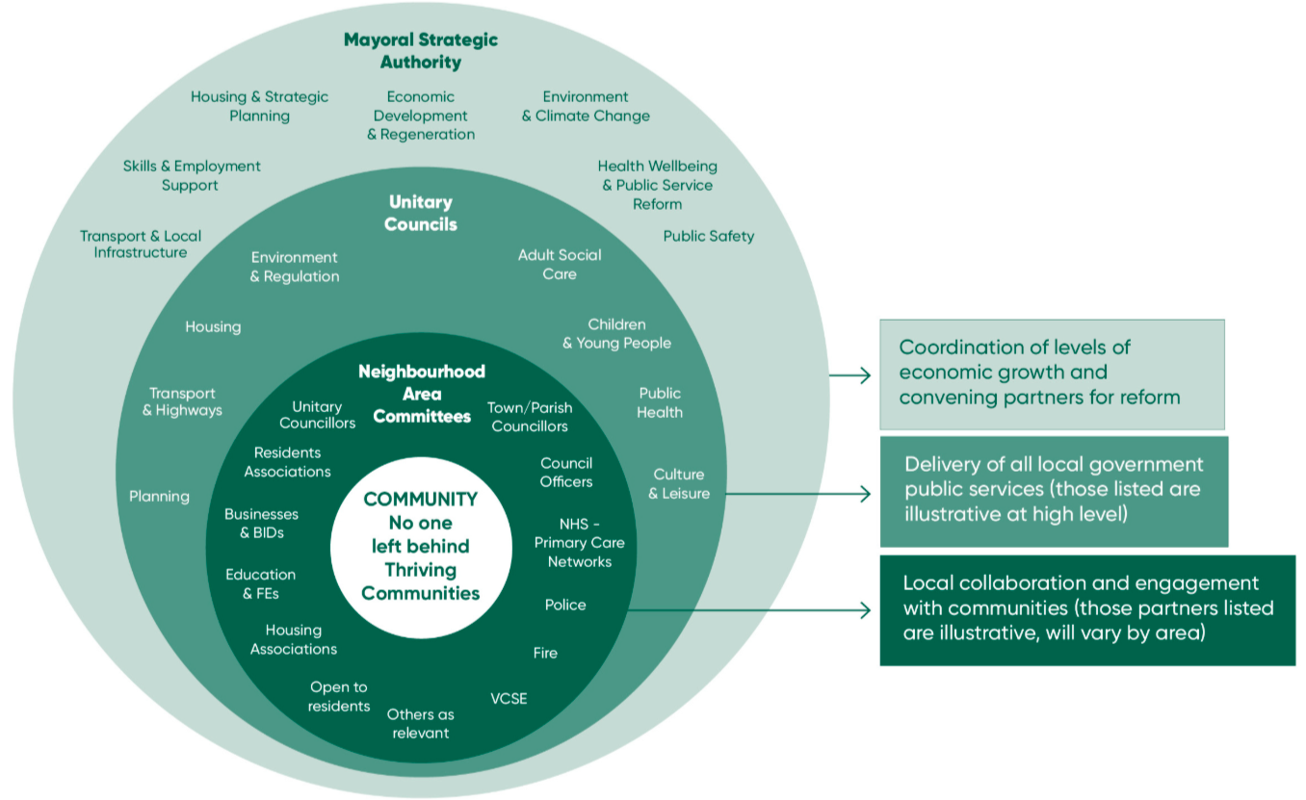
Illustration of the spatial levels and key partners for integrated partnership working and delivery

Slide 9
Membership and Ways of Working
During the pilot phase, NACs will meet monthly, likely moving to quarterly
Held in accessible venues in communities with options for virtual attendance
Recommendations to be developed on a consensus basis
Agendas, action notes and outputs will be published
Meetings open to the public
Insight packs developed for each area, with partner input, supporting focus and action planning
Approx. 15 - 21 members
Key sector partners including representatives from Health, Police, Fire and Rescue, Education, Business
Community: VCSE partners, nominated individuals from residents’ associations, youth representatives and other relevant community groups to ensure diverse input
Elected representatives: County Councillors, District and Borough Councillors and Town and Parish Councillors

Slide 10
Work in progress
We have drafted terms of reference for the NAC pilots which sets out the objectives, proposed membership, and their intended outputs
Areas we are working to define include:
  Appointment mechanism for core membership
  Appointment mechanism of Chair(s) and Vice-Chair(s)
  Split of representation among elected Members (SCC, D&B, Town/Parish)
  Resident involvement
  Approach to evaluation
  Potential to influence or allocate funding
We are developing 'Lets Talk' community conversations via in-person listening events and digital engagement to capture local resident voice on priorities, and update on actions taken by the NAC pilots in the form of 'You said we did'.
We are working with The Surrey VCSE Alliance to support participation and engagement with the NAC pilots for the wider Voluntary sector in each pilot area

Slide 11
How the NAC pilot areas have been selected
Roots in our ‘towns and villages’ approach
Economic analysis based on research conducted by Metro Dynamics. This was focused on town centre catchments and usage patterns to identify key towns
The first draft identified some towns as standalone ‘islands’ and the entire county was not covered
Rural areas were then linked to their nearest or most naturally associated town to fill the gaps
The latest Boundary Commission electoral divisions were used as the building blocks for each area
Draft boundaries were shared with elected Members at previous Member briefing and adjustments were made based on feedback and local knowledge
Boundaries adjusted to create manageable number of potential NAC areas across new unitaries including taking into account:
  Total number of committees
  Average population per area (c.50,000), while accommodating Surrey’s urban-rural diversity
  Mix of parished and unparished areas
Notes:
Metro Dynamics research: https://orbispartnerships.sharepoint.com/:b:/s/economy_and_growth/EaajYeCAcRJNhqAEw98MIXUBp8o9wYfEJoW0wPqYw1CJyw
The link is available for anyone with an SCC email.

Slide 12
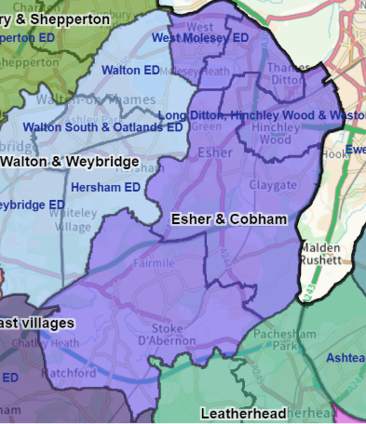
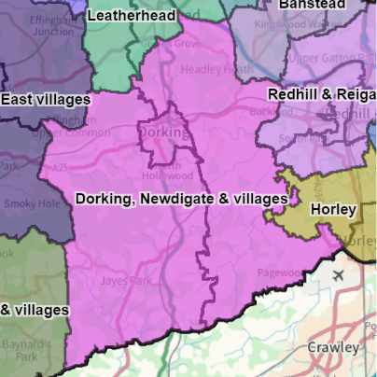
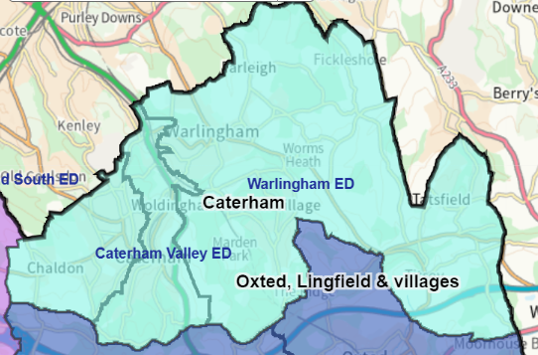
Pilot areas
Three NAC Pilots are being developed with input from colleagues and partners in the local areas including the health sector, police, the VCSE, and business. The pilots will take place in the following geographies:
The model will be tested in these three areas initially before considering the potential to scale up and inform a future blueprint for the new unitaries. There are also ongoing discussions with other local areas who may be ready in the autumn to join as a ‘fast follower’ pilot area.
Esher & Cobham
Dorking, Newdigate & Villages
Caterham & Warlingham

Slide 13
Evaluation approach – Test, Learn and Grow
To assess the progress and impact of the NAC pilots, we need to focus primarily on the effectiveness of the processes involved, while also starting to consider how we measure longer term impact for communities.
Test, Learn, Grow​
Regular data collection points with stakeholders.
Captures ongoing reflections throughout the pilot period.
Enables rapid adjustments and continuous improvement.
Impact Evaluation​
Assesses the extent NACs meet:
  The overarching goals.
  The specific aims of each individual NAC.
Connected to a behaviour change framework.
Aims/objectives
Test
Outputs
Grow
Learn
Impact

Slide 14
Next steps
July – Initial workshops with key partners held in three pilot areas
September – First official meetings held in three pilot areas
September-December – In-person listening events and digital engagement with residents in pilot areas to capture resident voice and priorities
October-November – Further meetings held in three pilot areas to produce local area action plans
December – Evaluation of three pilots to determine scalability
2026 – Consideration of further rollout of NAC model
Ongoing communications and engagement with Members, staff, partners and residents
Surrey County Council

Slide 15
Best practice from other authorities
The NAC model in Surrey has been informed by best practice such as Cornwall’s Local Area Partnerships, Durham’s Local Networks and Wiltshire’s Area Boards
The approach draws on key attributes from these organisations and any lessons they have learned during implementation
Key features of our approach drawing on these examples include:
  Consensus-based approach to decision-making
  Inclusive and diverse membership with accessible participation methods
  Open meetings with opportunity for public questions
  Co-production of local area action plans

Slide 16

General Insights from Areas Reviewed
Board Composition
  Core voting members: elected councillors
  Non-voting participants: community groups, Town & Parish Councils, public services
Common Powers & Functions
  Advisory role: make recommendations on local priorities and funding
  Develop and oversee local action or investment plans
  Host community events and forums for engagement
Resident Engagement
  Public meetings held 4–6 times/year
  Input gathered via surveys, forums, and direct contact
  Emphasis on transparency and local voice
Town & Parish Councils
  Involved in most boards, often as partners or consultees
  Some councils (e.g. Cornwall, Somerset) support devolution of services/assets
Officer Support
  Boards supported by Community Link Officers and Democratic Services
  Senior council officers provide oversight and coordination
Funding
  Boards manage or influence local grant funding
  Focus on community benefit and one-off projects
  Increasing reliance on external funding in some areas
Governance Trends
  Annual election of Chairs
  Use of working groups for specific issues
  Boards produce annual reports and self-assessments
  Emphasis on non-political, consensus-based decision-making
Our research looked at NAC or equivalents from:
Cornwall
Wiltshire
Durham
Westmorland and Furness
Cumberland
Somerset
Buckinghamshire

Slide 17
Cornwall Council: Case Study
Background:
  Cornwall Council became a Unitary Authority in 2009, merging the County Council and 6 District Councils.
  In 2023, 19 Community Network Panels were replaced with 12 Community Area Partnerships (CAPs).
Who’s Involved:
  Cornwall Councillors
  Town and Parish Councils
  Police and Health Services
  Voluntary and Community Sector Organisations
  Co-opted members from other organisations or individuals
Meeting Format:
  CAPs meet 4–6 times per year
  Held in Town Halls with virtual attendance options
  Open to the public
Leadership & Support:
  Each CAP elects a Chair and Vice-Chair (Cornwall Councillor or local representative)
  Supported by a Community Link Officer (one per CAP) and Community Support Assistant (support multiple CAPs)
  CLOs are part of Cornwall Council’s Localism Team
Governance & Engagement:
  Managed through a central Partnership Meeting and an Open Public Forum
  Forums allow residents to raise concerns and suggest initiatives
  Consensus is encouraged; formal voting used only when necessary
Notes:
Cornwall Council became a Unitary Authority in 2009 merging the services of the previous County Council and 6 District Councils.
What: Previously, Cornwall Council had 19 Community Network Panels before replacing them in 2023 with 12 new Community Area Partnerships (CAPs) as part of their Community Area Partnership Model.
Who: Cornwall Councillors, Town and Parish Councils, Police, Health services, and voluntary and community sector organisations. CAPs typically meet 4-6 times per year in a public setting which is open to members of the public. These are held at Town Halls with virtual options available. A CAP may invite representatives of other organisations, and individuals, to join it as co-opted members. A Chair and Vice-Chair is elected and may be held by any Cornwall councillor or named town and parish council representative within the partnership area. Each CAP is supported by a Community Link Officer (CLO) and Community Support Assistant. Each CLO is a member of the Localism Team which sits within Cornwall Council. The Localism Team administers, co-ordinates and facilitates the Partnership’s work with a focus on cross-boundary work to ensure an efficient, effective and equitable service across Cornwall.
How: Governance is managed through a central Partnership Meeting and an Open Public Forum as set out in the terms of reference. The open forums are the primary conduit for residents to raise concerns, suggest initiatives, and engage directly with local representatives and service providers. The Partnerships are encouraged to reach consensus on the issues it is considering with formal voting only necessary where there is none.

Slide 18
Cornwall model redesign
Cornwall changed from 19 Community Network Panels to 12 Community Area Partnerships.
Cornwall’s area partnerships need more power and support to take meaningful action on issues that matter - locally and across the county.
To deliver its ambitious goals and levelling up priorities, the Council must work better with communities. Area partnerships should lead this, taking action and holding services to account.
Stronger local connections are essential. Partnerships help communities support one another and guide council and partner engagement.
Resource pressures - including fewer councillors and tighter budgets - require a partnership model that’s efficient and sustainable.
While the Community Network Panels achieved success, 19 separate areas aren’t practical. A more consistent and manageable structure is needed.
Area partnerships must evolve to serve their communities and partners more effectively. This review continues the council’s journey toward continuous improvement.

Slide 19
Durham Council: Case Study
Background
  Became a Unitary Authority in 2009, merging the County Council and 7 District Councils
  Introduced 12 Local Networks (LNs) on 1 April 2025, replacing 14 Area Action Partnerships (AAPs)
  New structure aligns with electoral divisions following the 2023 Local Boundary Review
  Currently in a transitional phase
What Changed
  LNs adopt a more strategic, long-term approach with 4-year Local Network Action Plans
  Plans aim to align local efforts with Durham’s Inclusive Economic Strategy
  Focus areas (based on previous delivery):
    Environmental improvements
    Business support
    Tourism and inward investment
    Public transport and accessibility
    Active travel and IT connectivity
    Public safety and community buildings
Who’s Involved
  Local Network Panel is the main governance body (21 members):
    7 Councillors (max 6 County + 1 Town/Parish)
    7 Partner Representatives
    7 Community Members
  Panels must remain non-political
    Political office holders cannot serve as partner or community reps
    Robust conflict of interest processes in place
Meeting Format
  Panels serve 4-year terms
  Quorum of 10 required for decisions, including Chair or at least one Vice Chair
  All decisions require a vote with members present
  Each cohort (Councillors, Partners, Community) elects a Vice Chair annually
  Chair rotates annually among the three Vice Chairs
Notes:
Durham County Council became a Unitary Authority in 2009 merging the services of the previous County Council and 7 District Councils
Durham recently introduced 12 Local Networks (LNs) from 1 April 2025, which replaced 14 Area Action Partnerships (AAP). The new networks align to the new electoral divisions following the Government’s Local Boundary Review in 2023.
Durham is consequently in a period of transition.
A 2024 internal review by Durham Council stated that the new LN model would adopt “a more strategic approach to their work and develop focused four-year action plans to guide investment.”
The purpose of these plans is to identify opportunities for increased joined up working between local areas and Durham Council Services – with a focus on delivering Durham’s Inclusive Economic Strategy.
LNs are more strategically oriented than the former AAPs with work centred around focused Local Network Action Plans. These plans are developed by the Local Network based on robust evidence from local and strategic engagement and consultation, and local data profiles.
The plans are set to last for 4-years, in line with the panel the 4-year term served by the Local Network Panel.
No LN Action Plans have been published yet, but local delivery has previously focused on: Environmental improvements; support to local businesses; attracting new people and tourists; public transport; accessibility; active travel; IT connectivity; public safety; improving community buildings.
Their approach to resident engagement has not yet been finalised. Officer support has not yet been finalised.
The Local Network Panel is the chief governance mechanism of the LN. The LN panel consists of a maximum of 21 members serving a 4-year term. This will comprise seven councillors (a maximum of six county councillors and one Town and Parish councillor), seven partner representatives and seven community members.
There is a stipulation that panels should be non-political to ensure that party politics does not take priority over local issues. Robust processes for declaring interests have been established and County councillors, Town and Parish councillors, or other individuals holding office for a political party will not be eligible to serve as partner or community representatives.
No business can formally be agreed at a LN panel meeting unless there is a quorum of 10 LN panel members, which must include either the LN chair or at least one vice chair. LN panels will be required to hold a vote for all decisions with all LN panel members present in the room at the time the matter was tabled.
Each cohort (community, partners, councillors) will elect a vice Chair on an annual basis. The position of Chair will be taken by one of the three vice chairs and will rotate on an annual basis to allow each cohort's vice chair to sit as chair within the four-year cycle.
Officer support – The Head of Economic Development will monitor and review the operation of the Terms of References in consultation with the Portfolio Holder for Economy & Partnerships to ensure that the aims and principles are being achieved
The intention of LNs is to offer a more streamlined funding process. There is currently little information on the total funding pots available to them. However, under the old AAP model, each AAP was granted a budget of up to £145,000 for local projects and investments, as well as an administration budget for staffing. Each councillor also had a dedicated neighbourhood budget of £19,400.
Durham’s LNs have three guiding principles for their engagement with Town and Parish councils as set out in the Durham Local Councils Charter: Communication, Co-Operation and Consultation

Slide 20
Durham model redesign
Durham County Council transitioned from 14 AAPs to 12 LNs:
To improve focus on community development and empower local communities and individuals to take greater ownership in shaping their areas.
Local Networks are designed to be more strategic, developing focused four-year action plans to guide investment and deliver measurable outcomes.
These plans will promote joined-up working between LNs, council services, and external partners, supporting delivery of the County Durham Inclusive Economic Strategy.
Cabinet approved the new LN model in July 2023, recognising the need for a more streamlined and impactful structure to replace the existing AAP framework.
The County Durham Community Network and its 12 LNs will strengthen partnership working, offering agile support to communities, groups, and organisations in responding to local challenges.
The repurposed AAP Forum - now the County Durham Community Network - will broaden participation, aiming to involve more residents and stakeholders through its 15,000-member base.
New and traditional engagement tools will be used to boost community involvement, increase attendance at meetings and events, and ensure inclusive participation.
The LNs will focus on building stronger, more resilient communities, using their four-year action plans to guide strategic funding decisions and deliver long-term impact.

